Slide 1
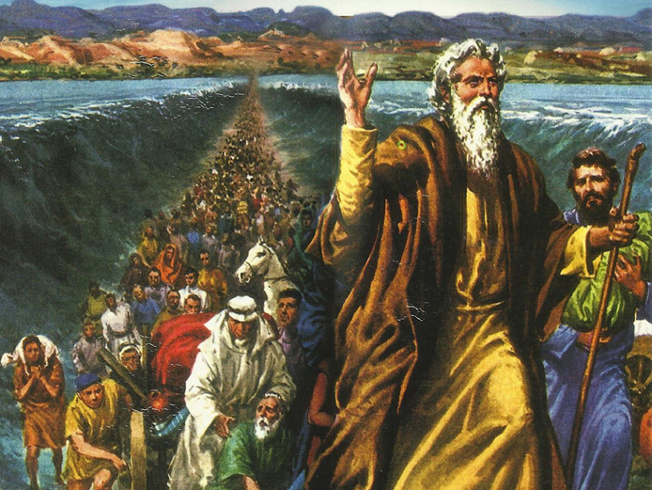
CATECHETICAL TEXTBOOK SERIES OF THE SYRO - MALABAR CHURCH
ON THE PATH OF SALVATION - 5
PEOPLE WHO AWAITED THE REDEEMER
5

Slide 2
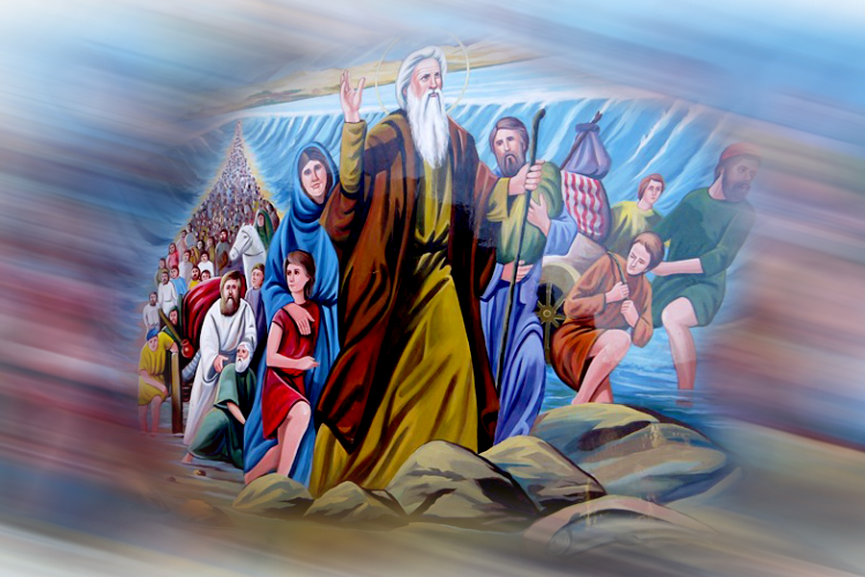
LESSON 6
TOWARDS FREEDOM

Slide 3
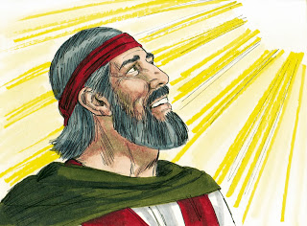
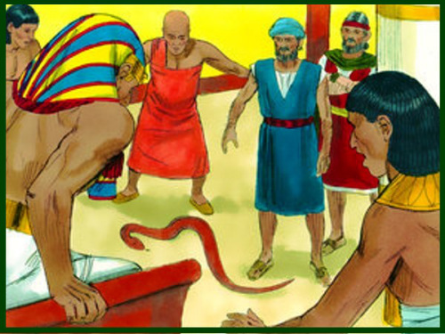
“ You must tell Aaron whatever I command you. Let Aaron take to the Pharaoh asking him to send the Israelites away from his Iand ” (Ex. 7:2).
“If the Pharaoh asks you for a sign, you must ask Aaron to take your staff and throw it down before you. It will change into a snake”.

Slide 4
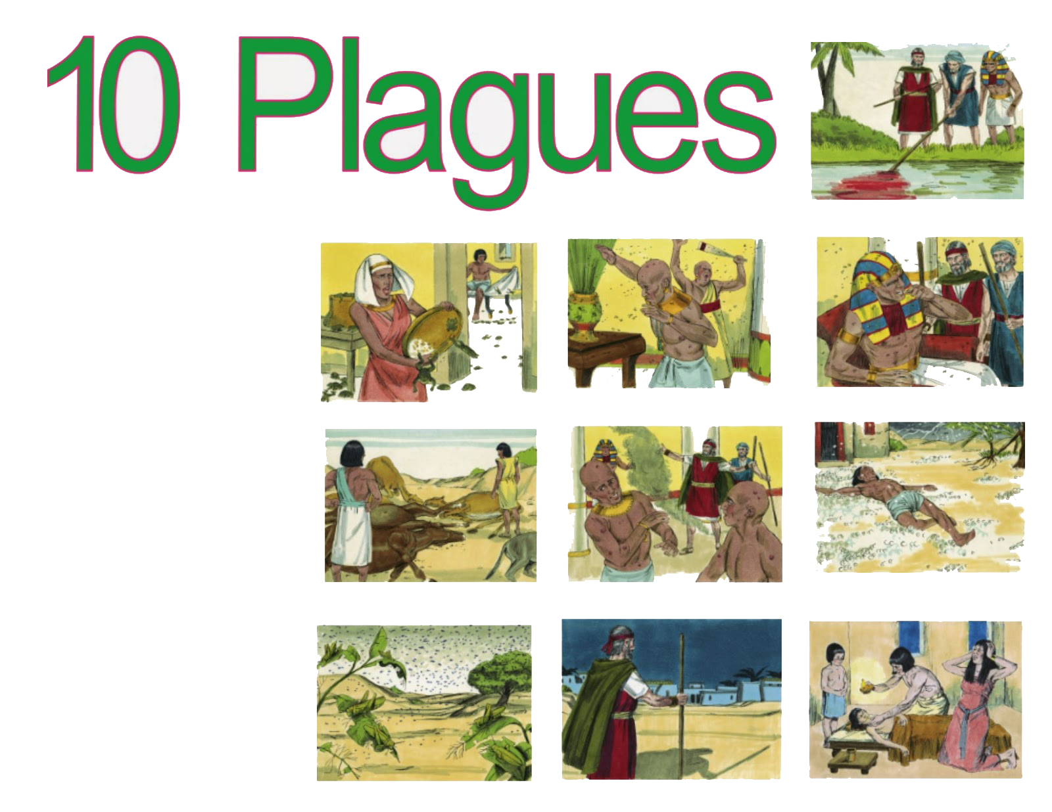
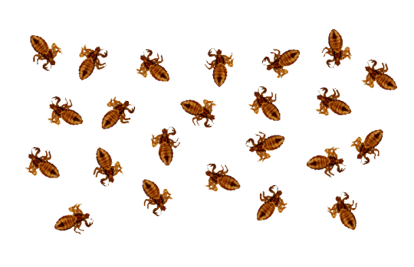
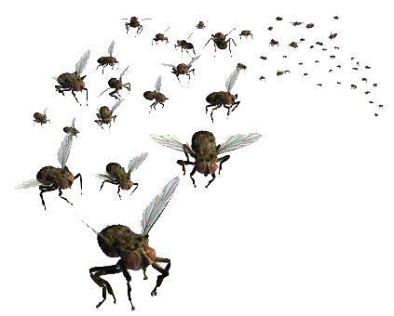


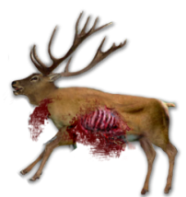
Ten plagues
1. Water turns to God.
2. Large number of frogs plague the land.
3. Gnats plague humans and animals.
4. The houses of the Pharaoh and the Egyptians filled with swarms of Flies.
5. The livestock of the Egyptians die of pestilence.
6. Festering boils afflict humans and animals.
7. Rain of hail, flash of fire and thunder.
8. Swarm of Iocusts.
9. Three days of darkness.
10. Death of every first born of the Egyptians.

Slide 5
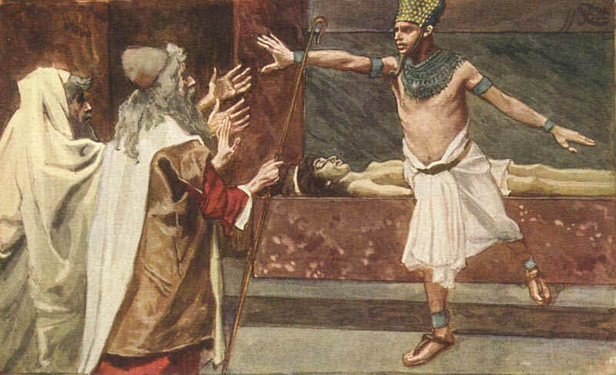
The tenth plague
“ I will send a final catastrophe over pharaoh and all of Egypt. Then he will let you go” (Ex.11:1).

Slide 6
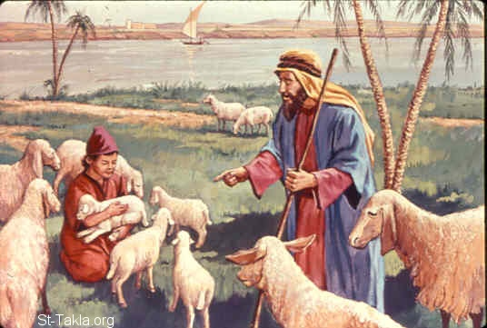
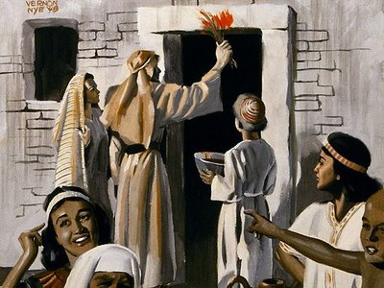
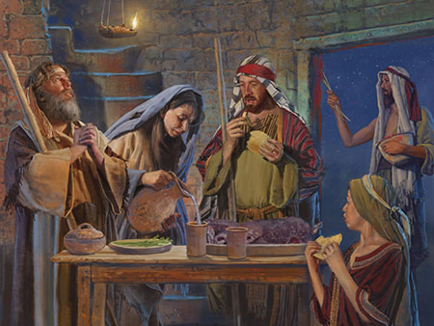
Passover celebration
This month shall be the first month of the year for you. Tell the whole congregation of Israel that on the tenth of this month they are to take a lamb for each household. This shall be without blemish and a one-year-old male. You shall keep it till the fourteenth day of his month. Then the whole congregation of Israel shall slaughter it at twilight. They shall take some of the blood and put it on the two doorpost and the lintel of the house in which they eat it. They shall eat the lamb that same right, roasted over the fire with unleavened bread and bitter herbs. This is how you shall eat it; your loins girded, your sandals on your feet, and your staff in your hand; and you must eat it hurriedly. For, it is the Passover of the Lord.

Slide 7
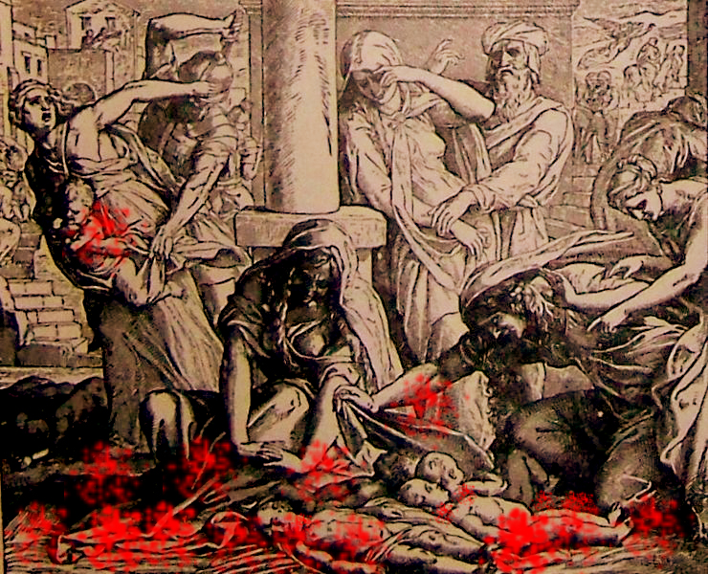
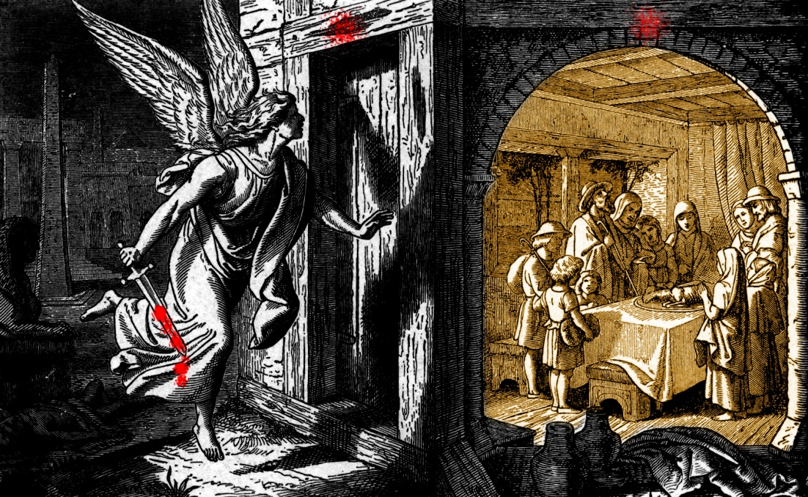
“I will pass through the land of Egypt that night, and I will strike down every firstborn in the land of Egypt, both human beings and animals; on all goods of Egypt I will execute judgments; I am the Lord. The blood shall be a sign for you on the houses where you live: when I see the blood, I will pass over you and no plague shall destroy you when I strike the land of Egypt. This day shall be a day of remembrance for you. You shall celebrate it as a festival to the Lord. Throughout your generations you shall observe it as a perpetual ordinance” (Ex.12:12-14).
“ Rise up, go away from my people, both you and the Israelites! Go, worship the Lord, as you said (Exodus 12:31).

Slide 8
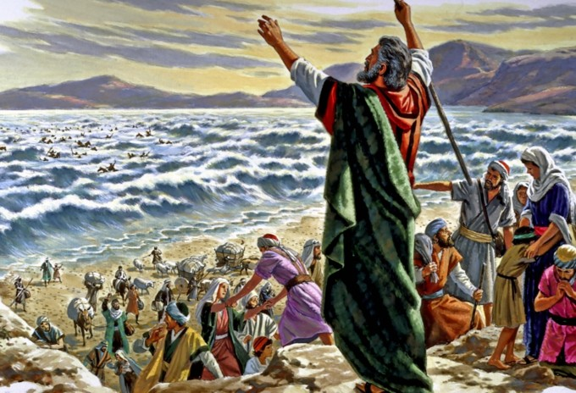
Crossing the sea
Stretch his hand over the sea. When Moses did so the water of the sea returned to its normal depth and the Egyptians were drowned. Thus the Israelites crossed the sea in a miraculous way with the help of the Lord.

Slide 9
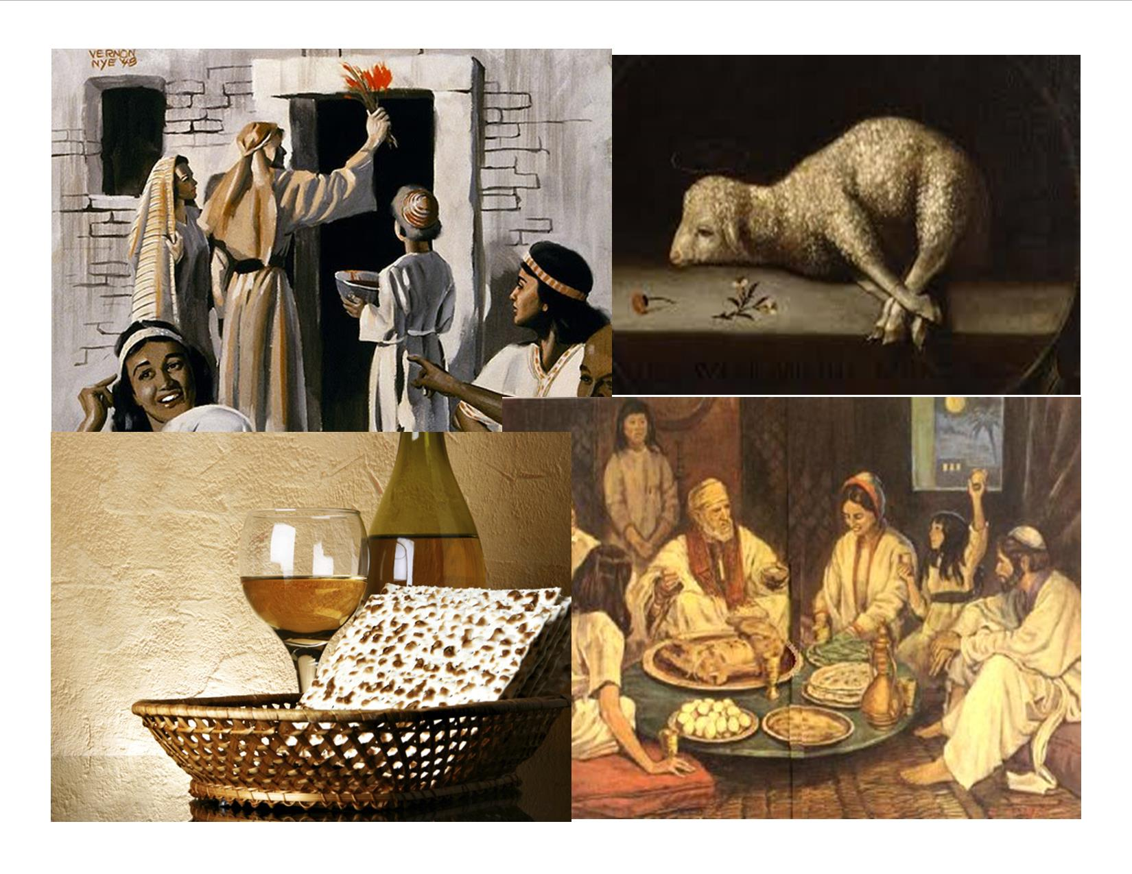
The feast of passover
As preparation for the liberation from Egypt the Lord had asked the Israelites to eat the Paschal or Passover meal. The word Passover means Passing over or transition. On the feast of Passover the people of Israel were celebrating the memory of their transition from slavery in Egypt to freedom. They were liberated under the leadership of Moses.

Slide 10
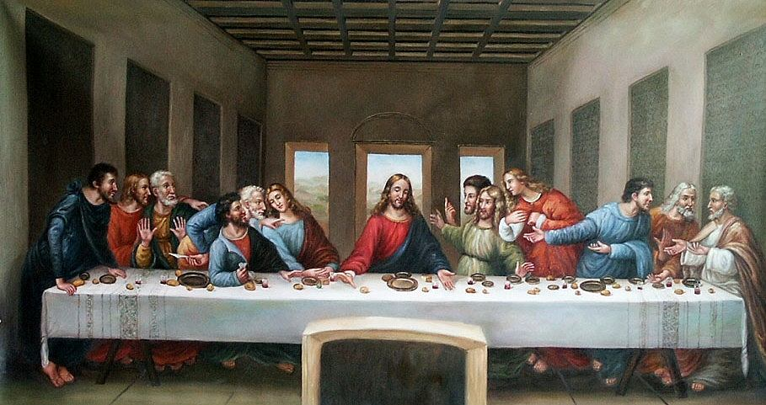
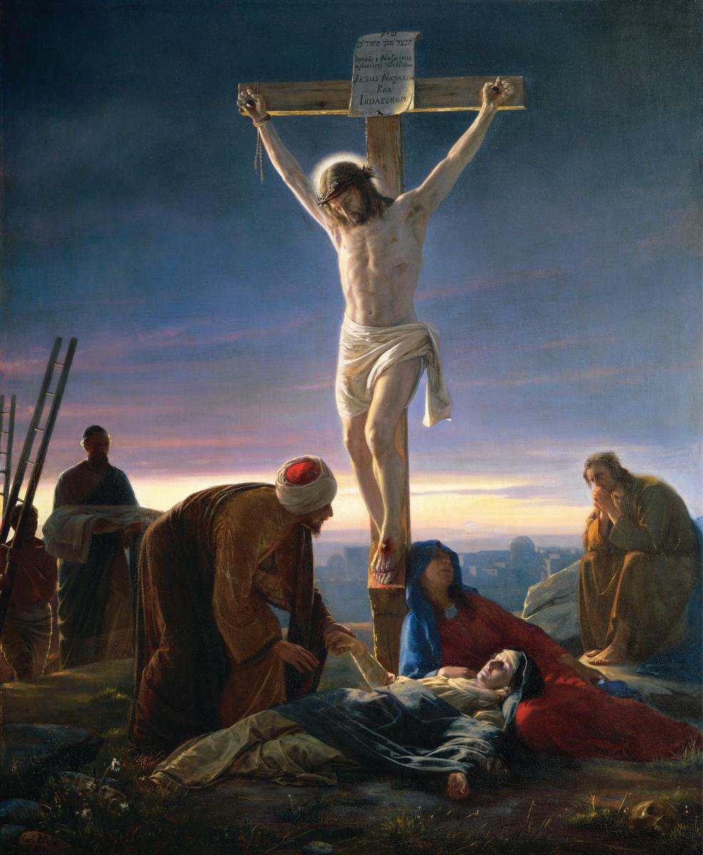
We, the people of the New Testament also celebrate the Paschal feast. In the new Paschal festival we celebrate the memory of humanity being redeemed from the slavery of sin. The humans achieved this liberation from the salavery of sin through the death of Jesus on the cross.

Slide 11
Let us pray
O God who saved Israel from the power of Pharaoh save us also from the power of evil.

Slide 12
READ AND RECOUNT
Narrate the event of the killing of all the firstborns of Egypt
(Exodus 11:1-10)

Slide 13

WORD OF GOD FOR GUIDANCE
“ The Lord is my strength and my might and has become my salvation” (Exodus 15:2).

Slide 14
MY DECISION
As Moses overcome the problems of life, with trust in God, I will also trust in God in the problems of my life..

Slide 15
LET US DO
Put the following in the proper order
1. The people of Israel ate the paschal meal.
2. Pharaoh accepted his defeat.
3. The angel of God killed all the firstborn of Egypt.
4. The Egyptians compelled the Israelites to leave their land.
5. Pharaoh and his army pursued the Israelites
6. Moses stretched out the staff over the sea and divided it.
7. The Israelites journeyed through the wilderness and reached the sea.
8. The Egyptians who followed the Israelites through the divided sea were drowned in the water.
9. The Israelites walked through the divided sea as if through dry land.
10. The way through the sea was refilled with water.
1. The people of Israel ate the paschal meal.
2. Pharaoh accepted his defeat.
3. The angel of God killed all the firstborn of Egypt.
4. The Egyptians compelled the Israelites to leave their land.
5. The Israelites journeyed through the wilderness and reached the sea.
6. Moses stretched out the staff over the sea and divided it
7. The Israelites walked through the divided sea as if through dry land.
8. Pharaoh and his army pursued the Israelites
9. The way through the sea was refilled with water.
10. The Egyptians who followed the Israelites through the divided sea were drowned in the water.
1
2
3
4
7
6
9
5
10
8

Slide 16
LET US FIND OUT THE ANSWER
1. What was the sign that God worked through Aaron before Pharaoh?
2. Why did God send ten plagues over Egypt?
3. What was the direction given by God for the celebration of Paschal meal?
4. What was the tenth plague which afflicted Egyptians?
5. What is the meaning of the word pass-over?
6. Why did the Israelites celebrate the feast of pass-over

Slide 17



Thank you

